Slide 1
Module 3 Ensemble Learning Boosting
Raghu Prasad K S
9845547471

Slide 2
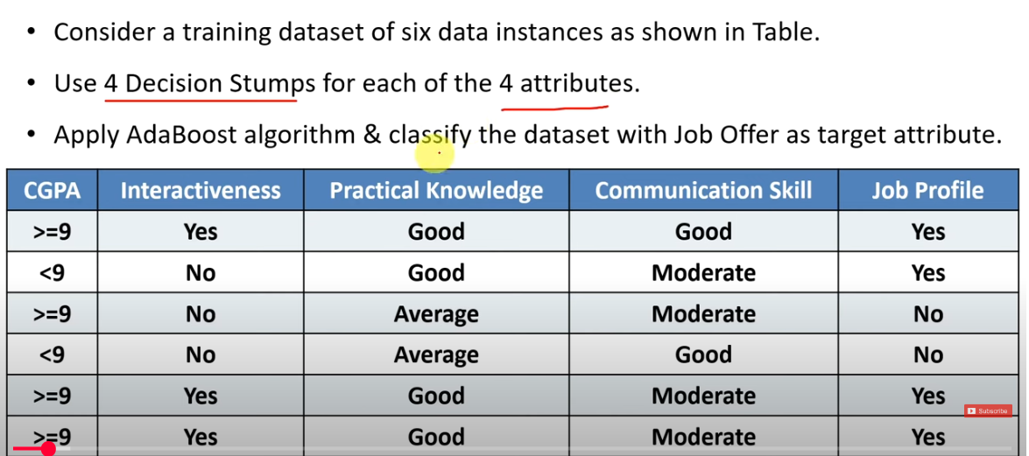
AdaBoost-Solved Problem

Slide 3
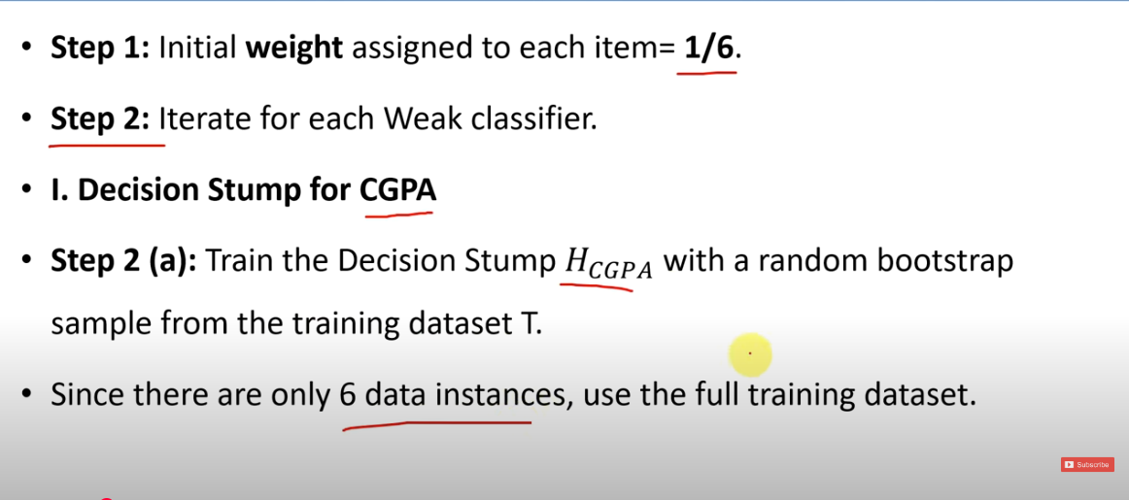
AdaBoost-Solved Problem

Slide 4
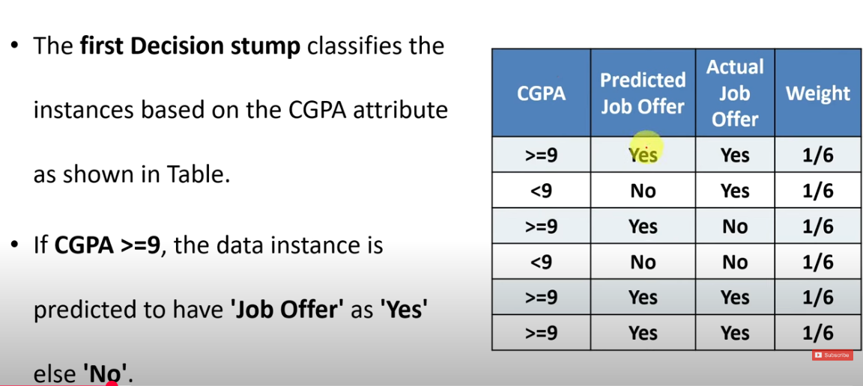
AdaBoost-Solved Problem

Slide 5
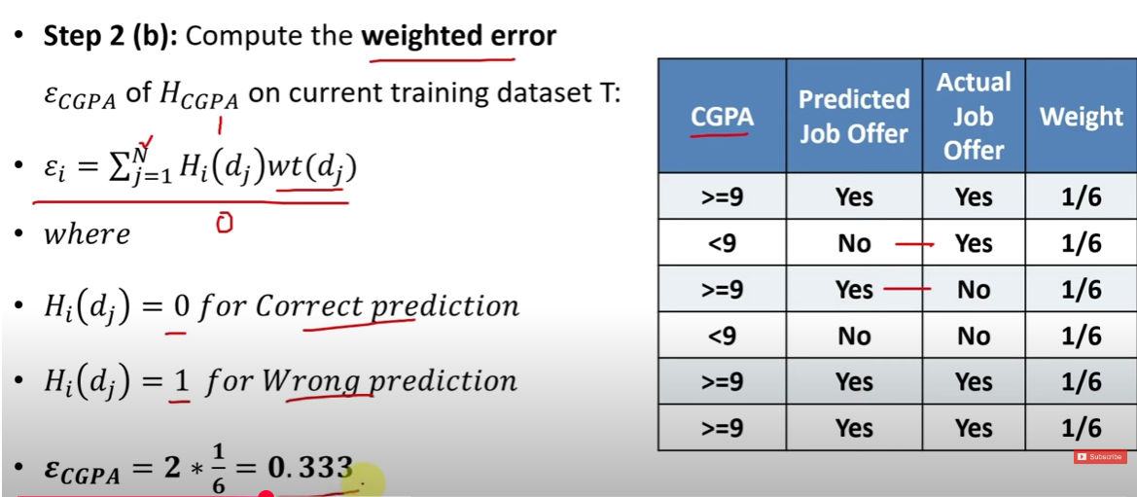
AdaBoost-Solved Problem

Slide 6
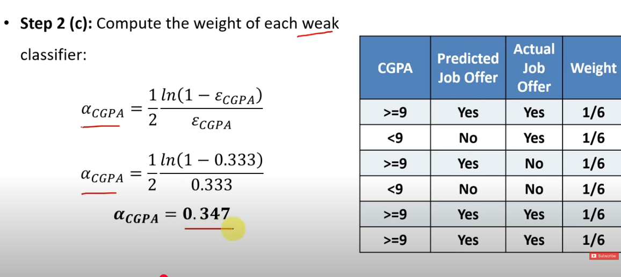
AdaBoost-Solved Problem

Slide 7
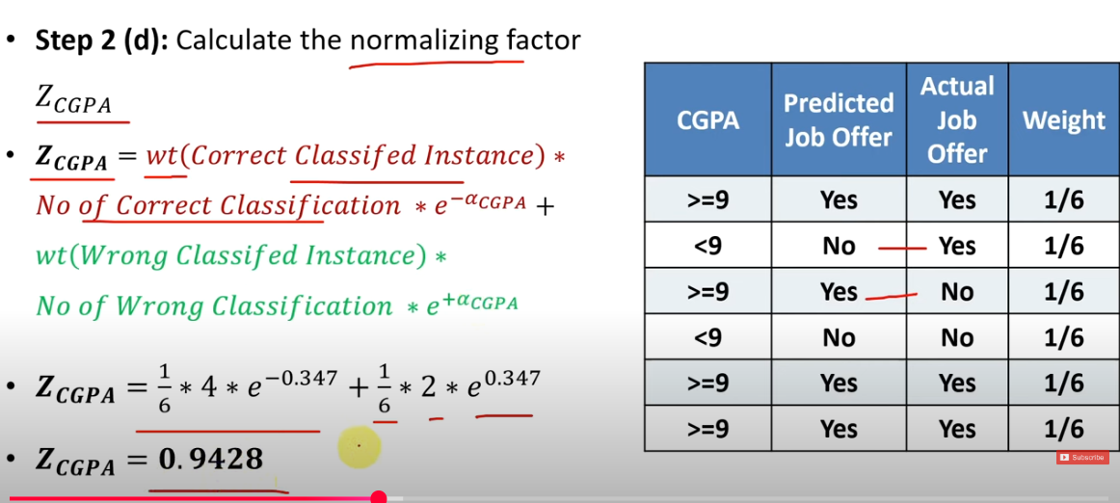
AdaBoost-Solved Problem

Slide 8
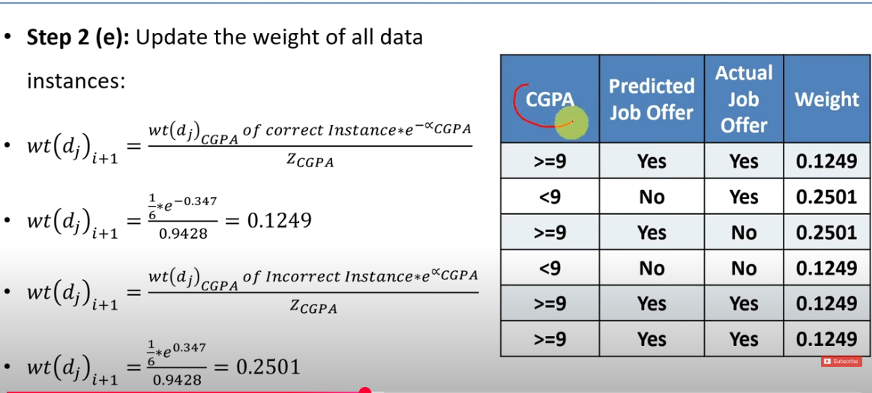
AdaBoost-Solved Problem

Slide 9
AdaBoost-Solved Problem

Slide 10
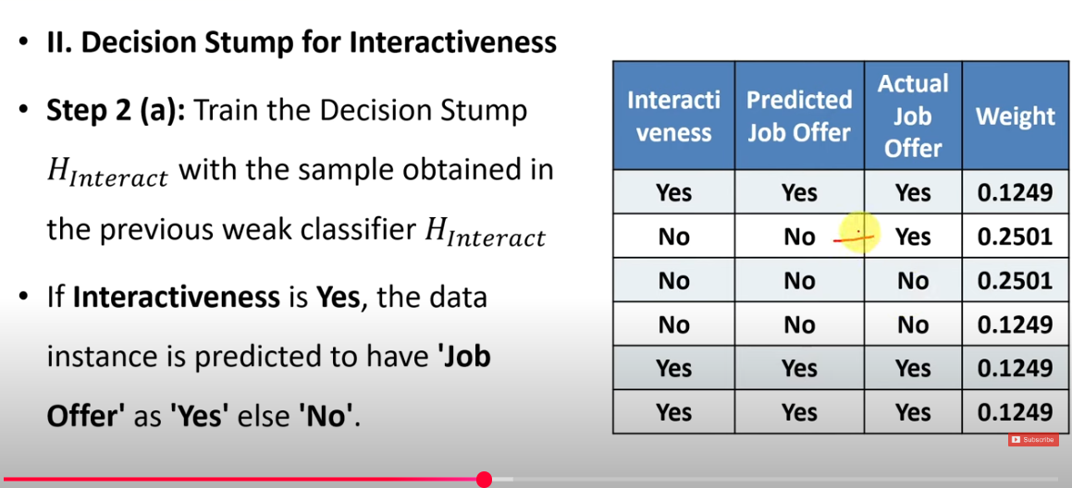
AdaBoost-Solved Problem

Slide 11
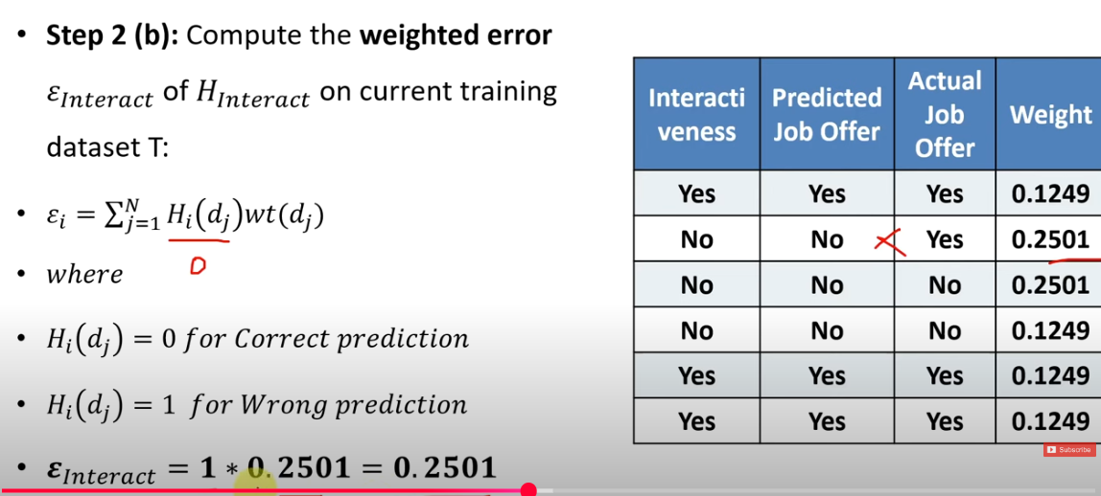
AdaBoost-Solved Problem

Slide 12
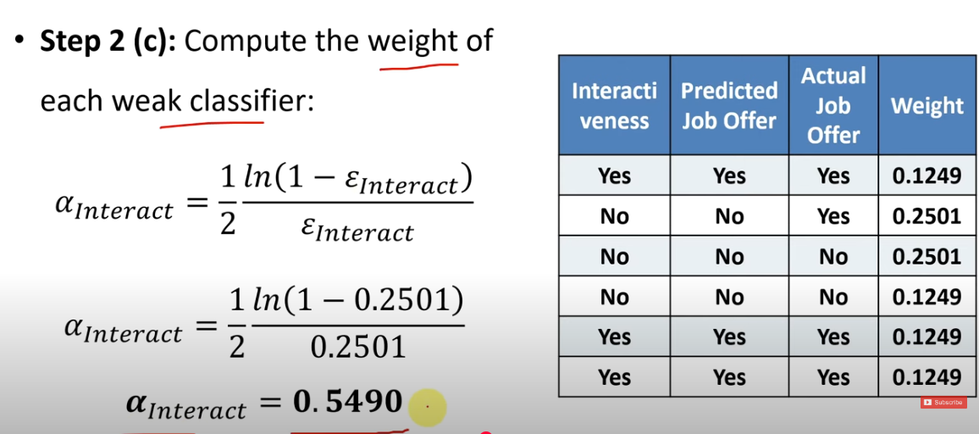
AdaBoost-Solved Problem

Slide 13
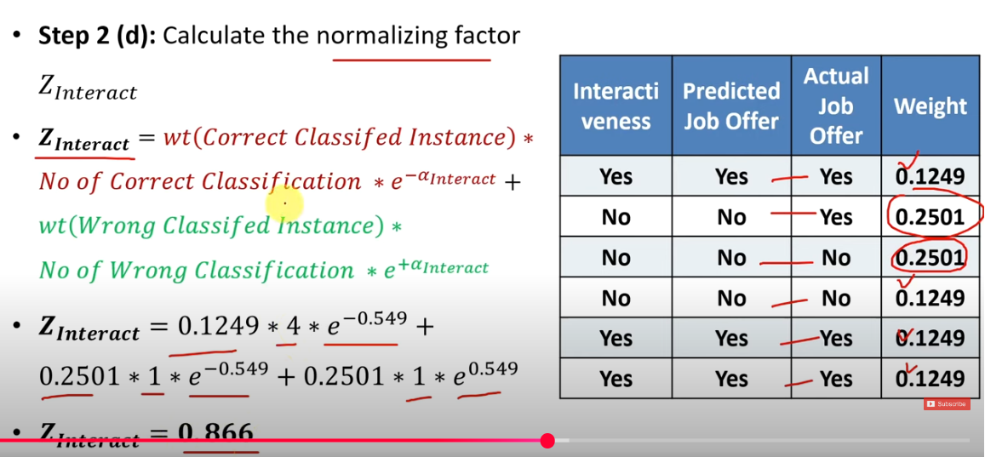
AdaBoost-Solved Problem

Slide 14
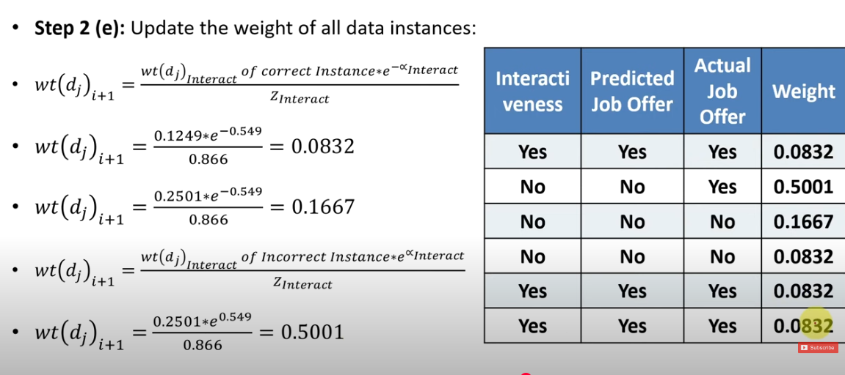
AdaBoost-Solved Problem

Slide 15
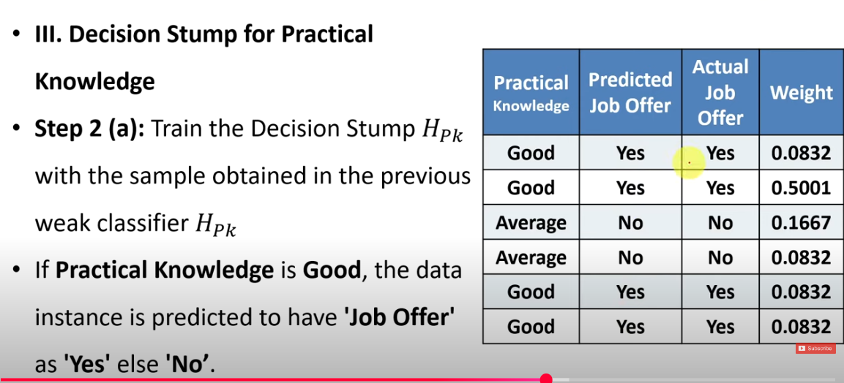
AdaBoost-Solved Problem

Slide 16
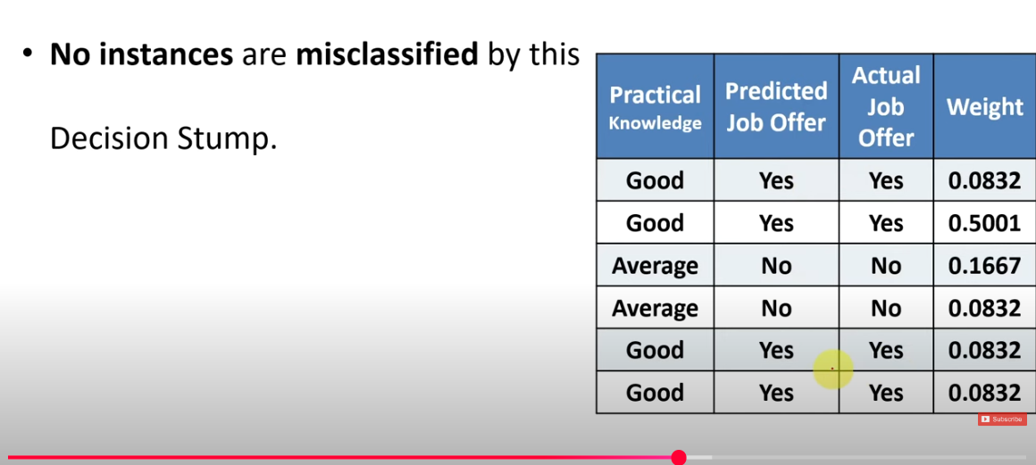
AdaBoost-Solved Problem

Slide 17
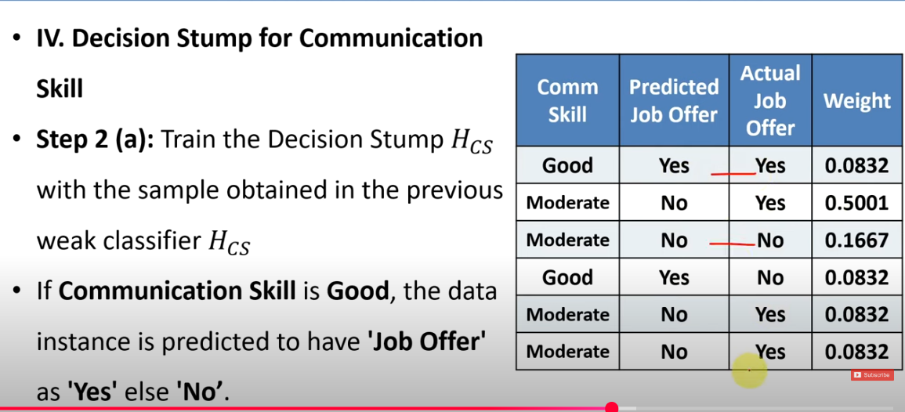
AdaBoost-Solved Problem

Slide 18
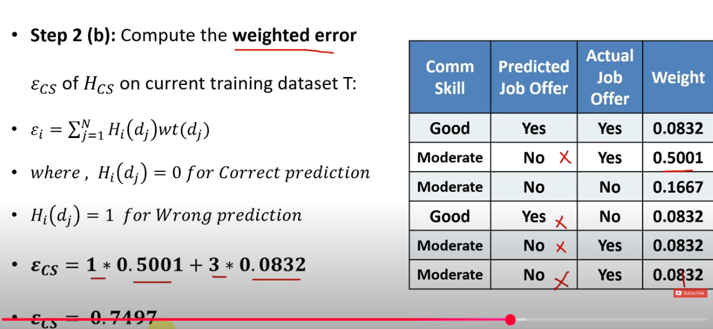
AdaBoost-Solved Problem

Slide 19
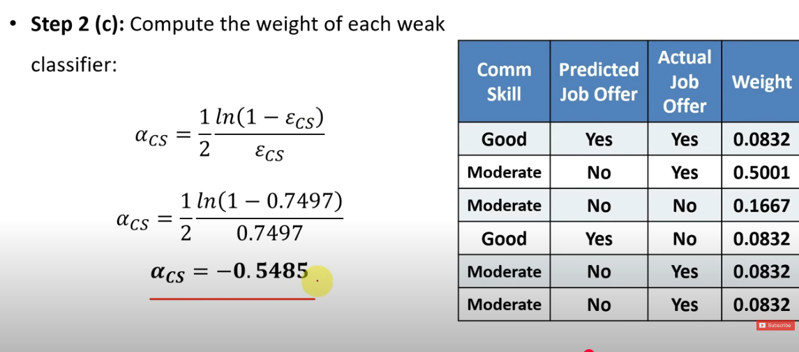
AdaBoost-Solved Problem

Slide 20
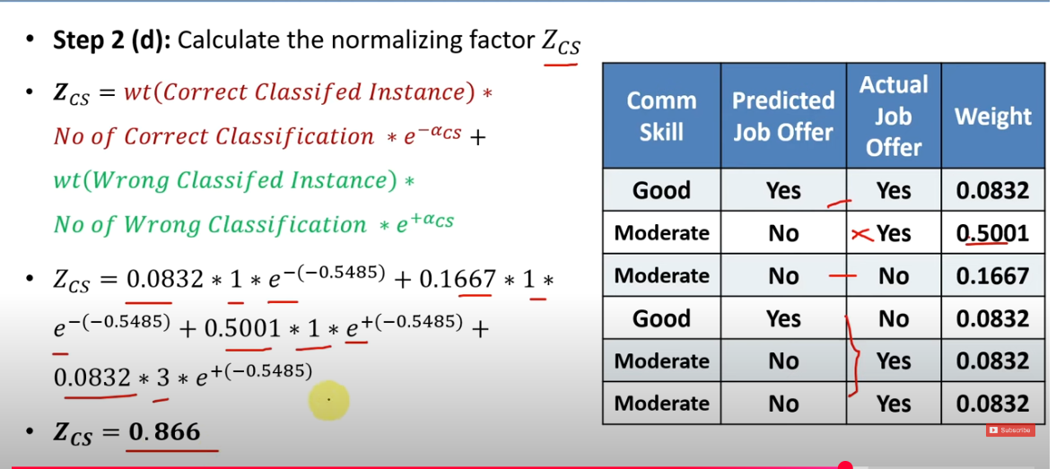
AdaBoost-Solved Problem

Slide 21
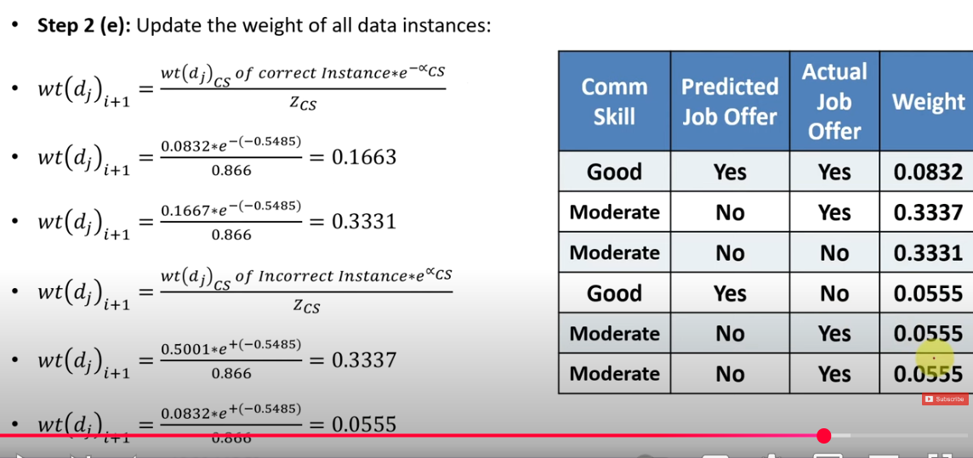
AdaBoost-Solved Problem

Slide 22
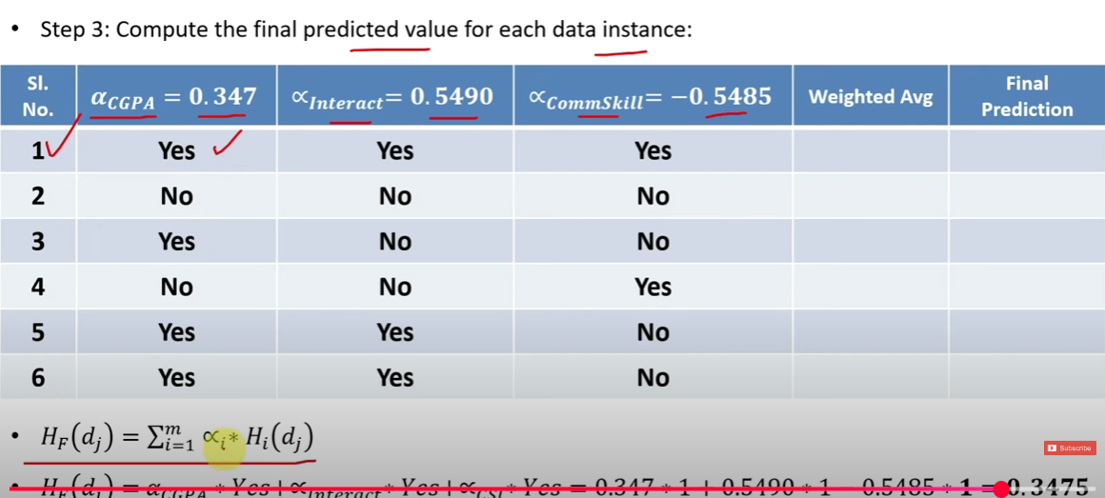
AdaBoost-Solved Problem

Slide 23
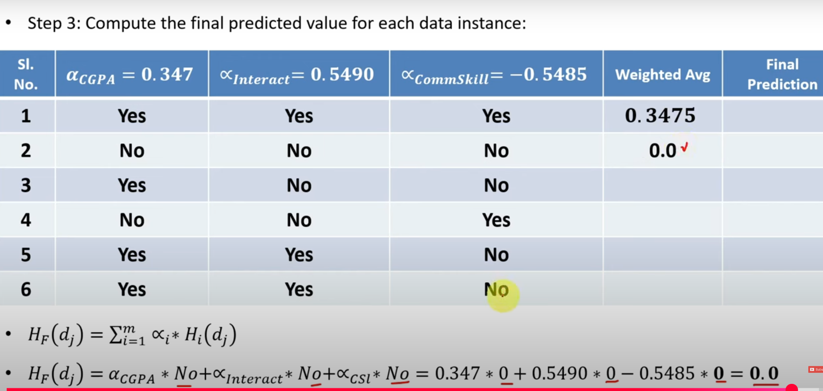
AdaBoost-Solved Problem

Slide 24
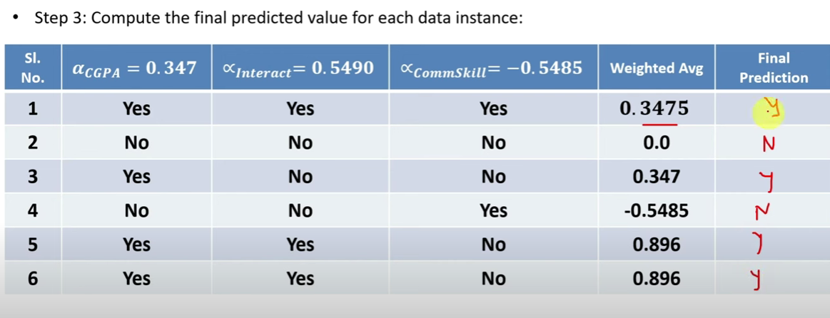
AdaBoost-Solved Problem

Slide 25
Reference
Introduction
https://www.youtube.com/watch?v=eNyUfpGBLts
Programs
https://www.geeksforgeeks.org/machine-learning/random-forest-algorithm-in-machine-learning/

